Slide 1
User Research: Overview and Highlights
Katie Elfering
May 2017
Notes:
The UI Model for the Bing Knowledge platform. The UI Platform for the data platform.

Slide 2


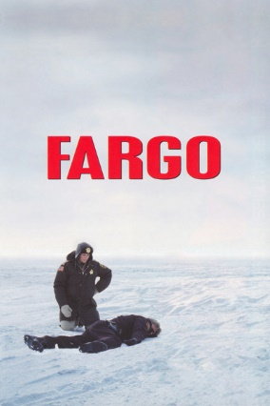



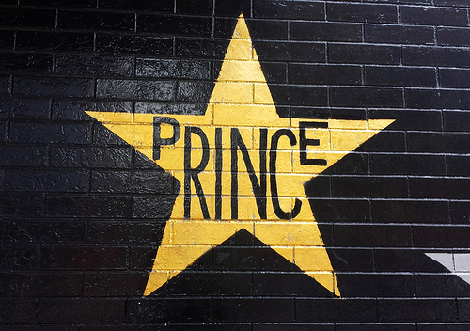
Who Am I?

Slide 3
What is design/user experience research?

Slide 4

Great products…
Are liked, used, and recommended
Satisfy users’ wants, needs, and preferences
Have what it takes to get people to return for more
Create brand loyalty and love
We get there with UX research!

Slide 5
BUSINESS PLANNING
Market landscape; business planning; audience identification
TARGET AUDIENCE
Customer definition, identification, needs & opportunities
DESIGN AND USER EXPERIENCE
Feature ideation; user feedback
Notes:
Many questions. My team is focused on questions relating to the user experience, interaction and design.
There are other research teams focused on other questions, such as:
Business Planning answers questions about market share and the potential for monetization
Marketing answers questions about how to messaging and awareness

Slide 6
Customer Obsessed
Notes:
Satya says that Microsoft needs to be customer-obsessed, and that’s what design/user research is. We want to know everything we can about our users, their needs, and how to best serve them through our products, features, services, etc.

Slide 7
Who are our users? What do they want and need?
How do they feel about our products? How do they feel about our design? How can we make that better?
Is it usable? How do people use it? How do people want to use it? How can we make it more usable?
What features are missing? What features are extraneous?
Who are our competitors? What experiences are they building? How do people feel about these products and features?
What is happening in the industry at large that we can use to improve our products? What do we need to be paying attention to?
What don’t we know that we wish we knew?

Slide 8
How do we answer those questions?

Slide 9
Richard Jacques
Kim Wilton
Eric Schuh
Melroy D’Souza
Samantha Neufeld
Katie Elfering
Camille Basilio
Chris Jewell
Emma Williams
Michael Kroll
Cyrus Kanga
Jordi Ribas
Kathy Caricaburu
Kristina Behr
Kristen Kennedy
Kristin Dean
Karen Reed
Mark Stumpf

Slide 10
Richard Jacques
Kim Wilton
Eric Schuh
Melroy D’Souza
Samantha Neufeld
Katie Elfering
Camille Basilio
Chris Jewell
Windows Search
Edge Search
Bing@Work
Ruby
Target Audience Understanding
Bing Fans
Bing Insiders
Strategic Research
Multimedia
Local
News
Segments
AI
Agents
Zo
Content
News
Sharing
Collections
Engagement
Behaviors
AI
Bots
EQ
AI
Chatbots
Opal
Maps/Local/Geo
Seeing AI

Slide 11
What do people do, why, how? Do our features meet users’ needs?
What people do
What people do
Why they do it & how to fix/improve
How many & how much
What people say
What people say
Fewer people
Many people

Slide 12
Natural use of the product
What people do
Eye tracking
Clickstream analysis
A/B testing
↑
Ethnographic/field studies
Expert review
↓
True intent studies
Diary/camera studies
Customer feedback
Intercept surveys
What people say
Fewer people
Many people

Slide 13
Scripted use of the product
What people do
Eye tracking
Usability benchmarking (lab)
Lab studies
Usability
Quick pulse
RITE
“Speed dating”
Moderated remote usability studies
Unmoderated remote panel studies
Unmoderated UX studies
What people say
Fewer people
Many people

Slide 14
Not using the product (de-contextualized)
What people do
↑
Expert review
Office hours
↓
Focus groups
Interviews
Online surveys
What people say
← Card sorting →
Fewer people
Many people

Slide 15
Combined natural use, scripted and de-contextualized
What people do
↑
Expert review
Office hours
↓
Bing Fans
Participatory design
← Concept testing →
← Desirability studies →
What people say
Fewer people
Many people

Slide 16
Agile methods (quick turn-around)
What people do
Lab studies
Quick pulse
RITE
“Speed dating”
Moderated remote usability studies
Unmoderated remote panel studies
↑
Expert review
Office hours
↓
Unmoderated UX studies
Bing Fans
← Concept testing →
Diary/camera studies
Customer feedback
← Desirability studies →
← Card sorting →
Online surveys
What people say
Fewer people
Many people

Slide 17
All together now!
What people do
Eye tracking
Clickstream analysis
A/B testing
Usability benchmarking (lab)
Lab studies
Usability
Quick pulse
RITE
“Speed dating”
Moderated remote usability studies
Unmoderated remote panel studies
↑
Ethnographic/field studies
Expert review
Office hours
↓
True intent studies
Unmoderated UX studies
Bing Fans
← Concept testing →
Diary/camera studies
Customer feedback
← Desirability studies →
← Card sorting →
Participatory design
Focus groups
Interviews
Intercept surveys
Online surveys
What people say
Fewer people
Many people

Slide 18
Who gives feedback?
Studio Office Hours
Bing fans
Remote study participants
Panel participants
Agile study participants
Lab study participants
Survey respondents

Slide 19
Methods in action

Slide 20
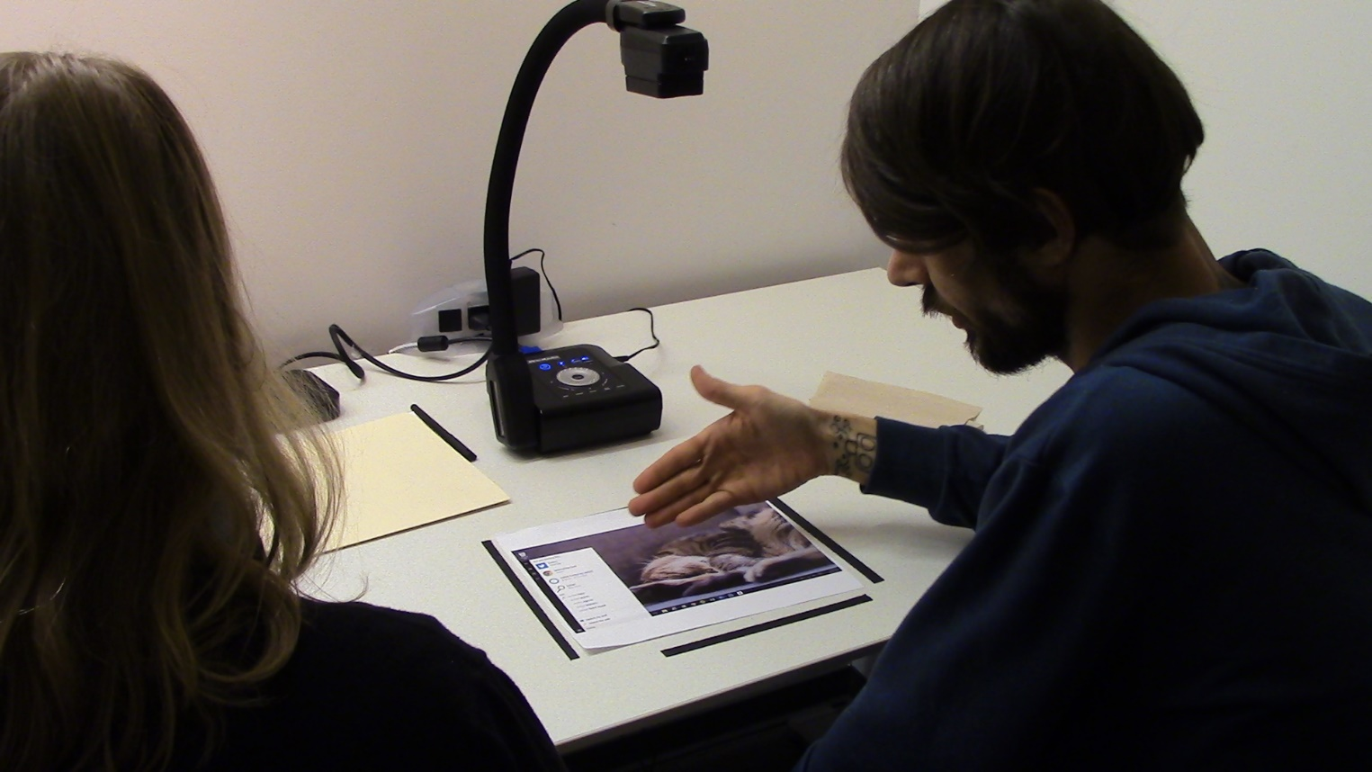
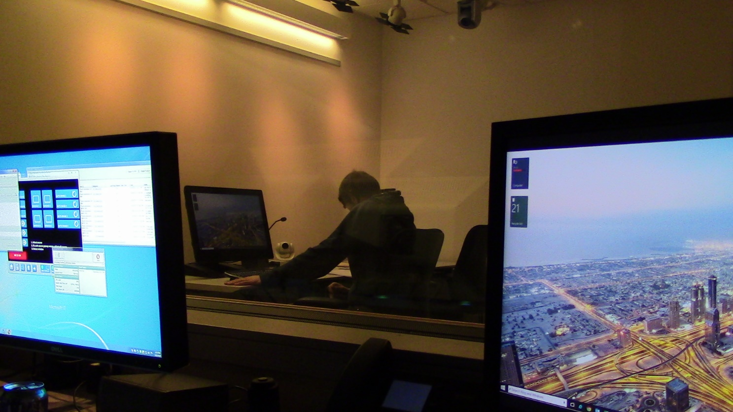
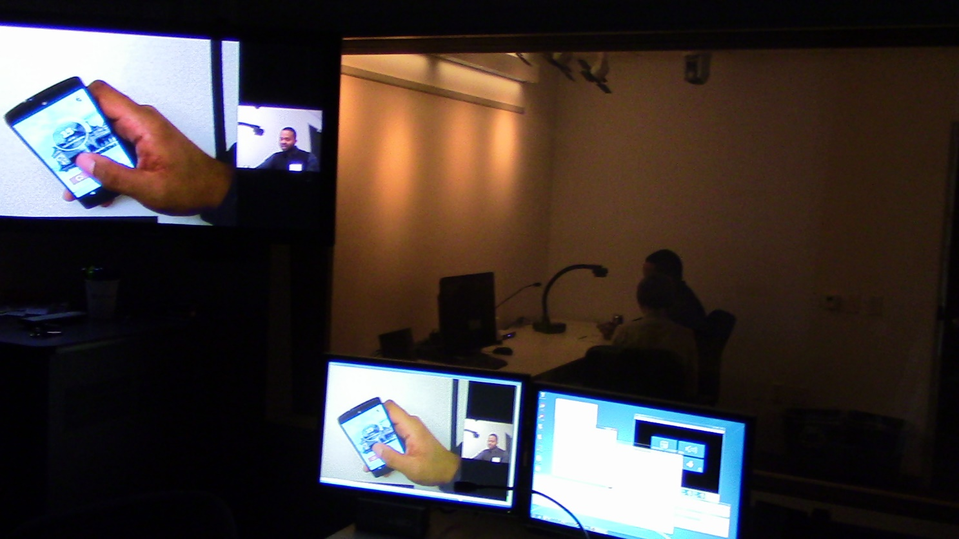
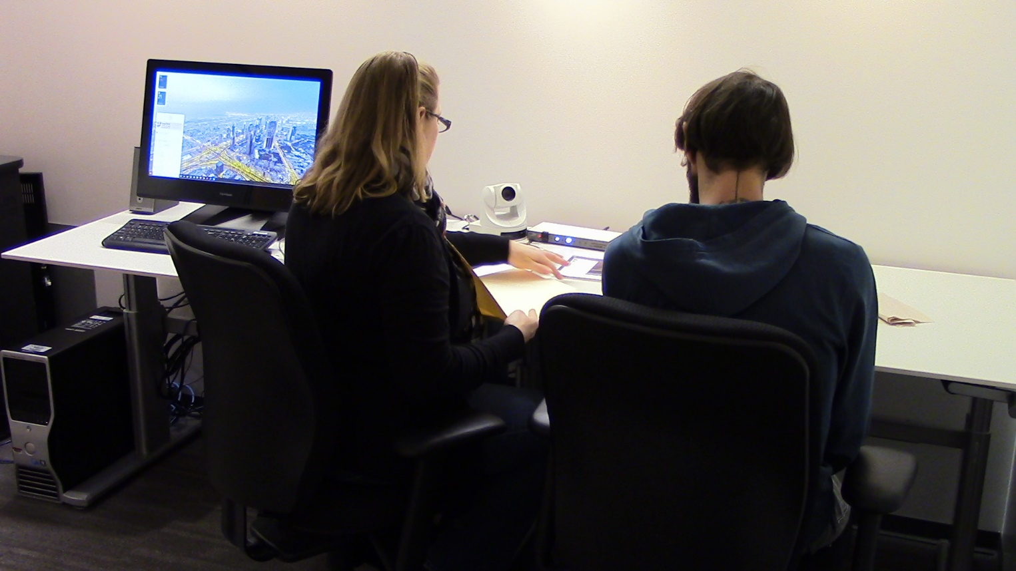
Lab study

Slide 21
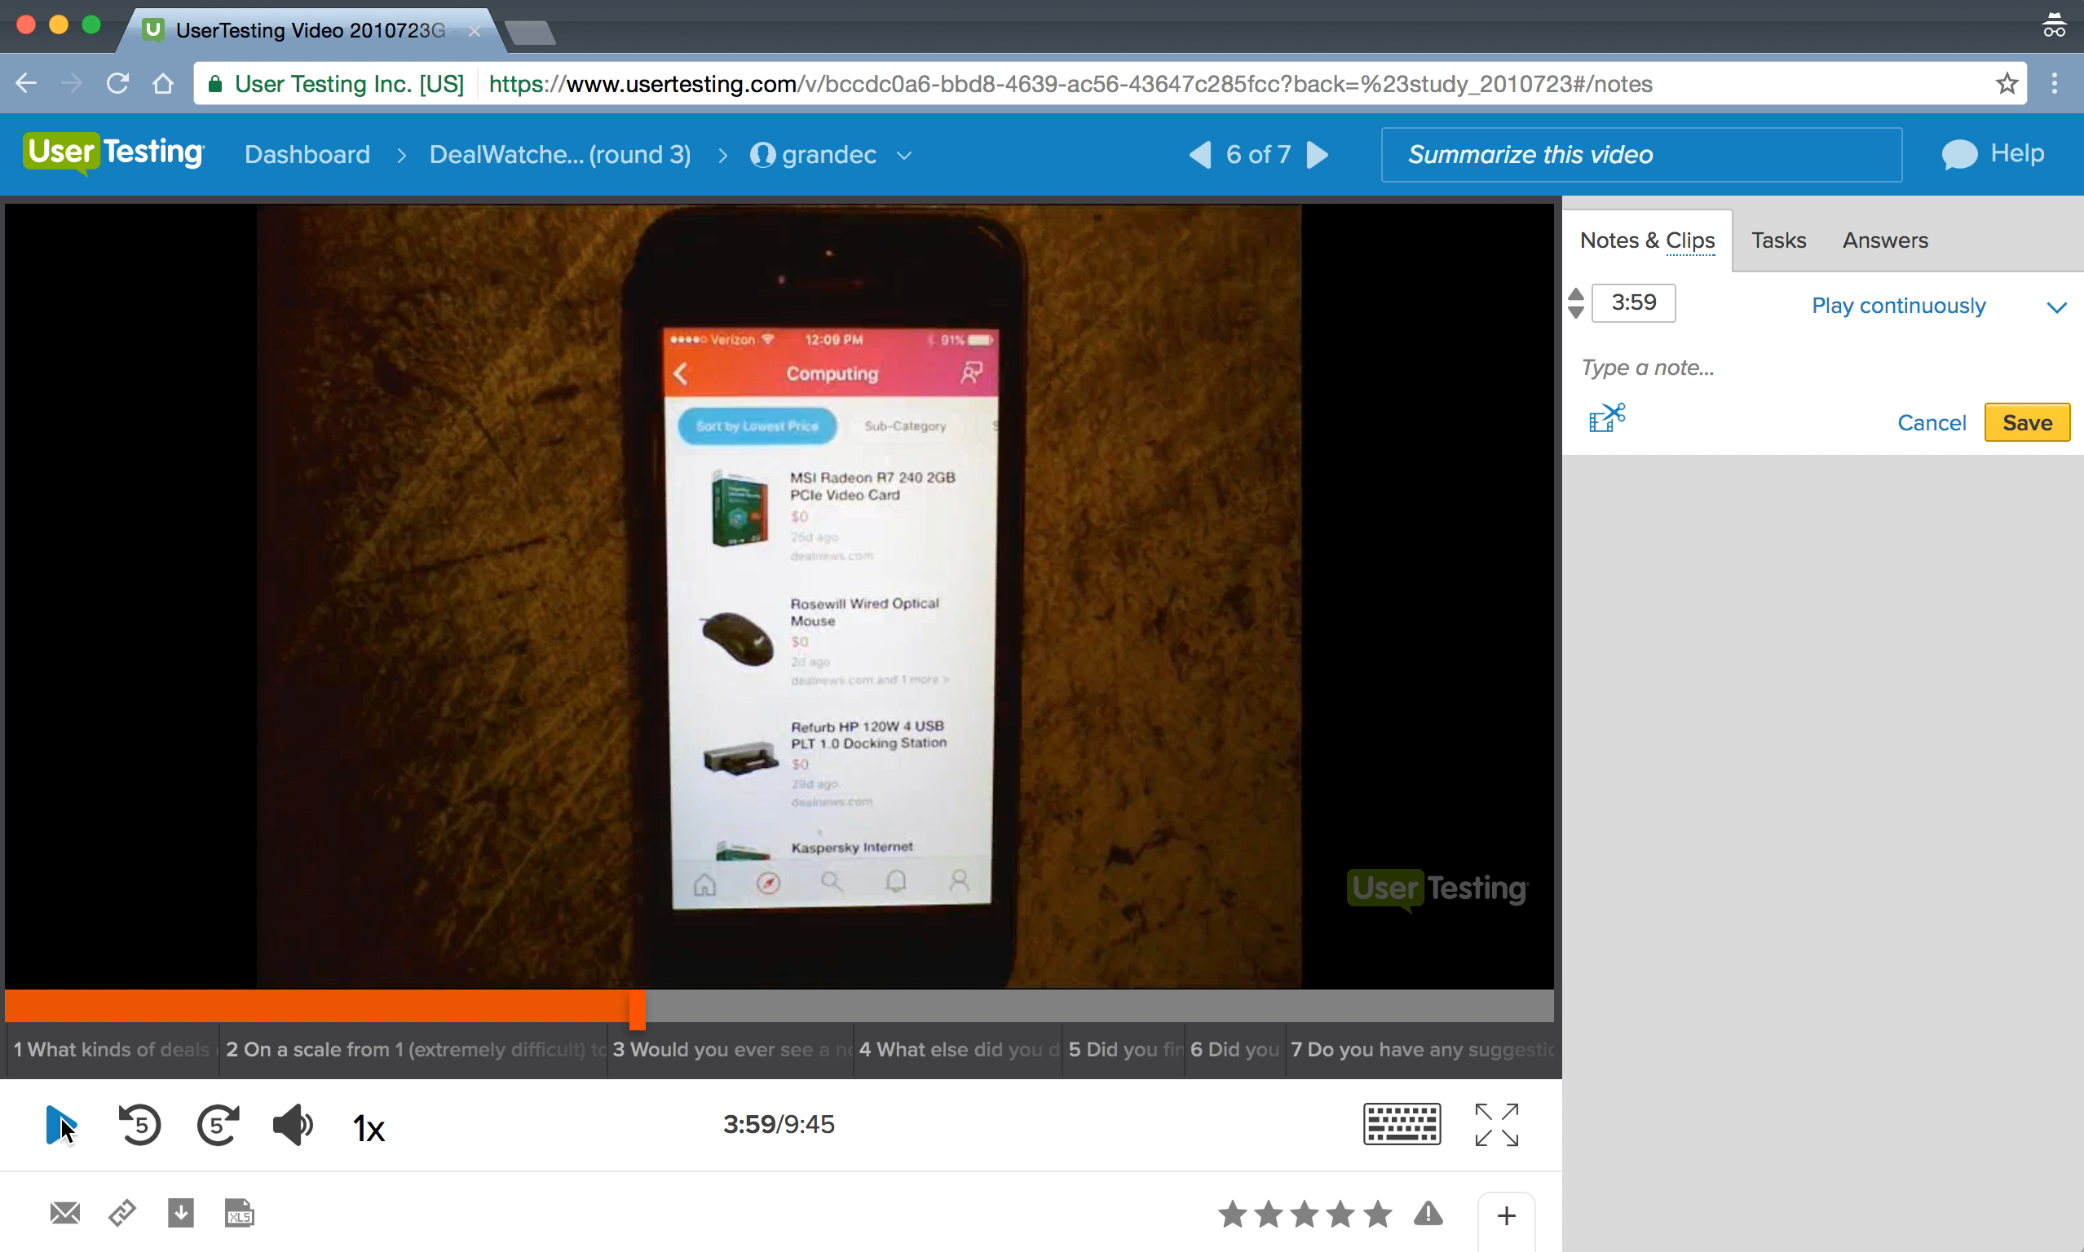
Remote usability study
Moderated remote study

Slide 22

In-context research
Home Visits
Ethnographic Research
Longitudinal Studies
Diary Studies
Advantages:
Observe users in their natural environment
Insights more reflective of actual use
Observe multiple instances of use vs. single instance
Understand use over time

Slide 23
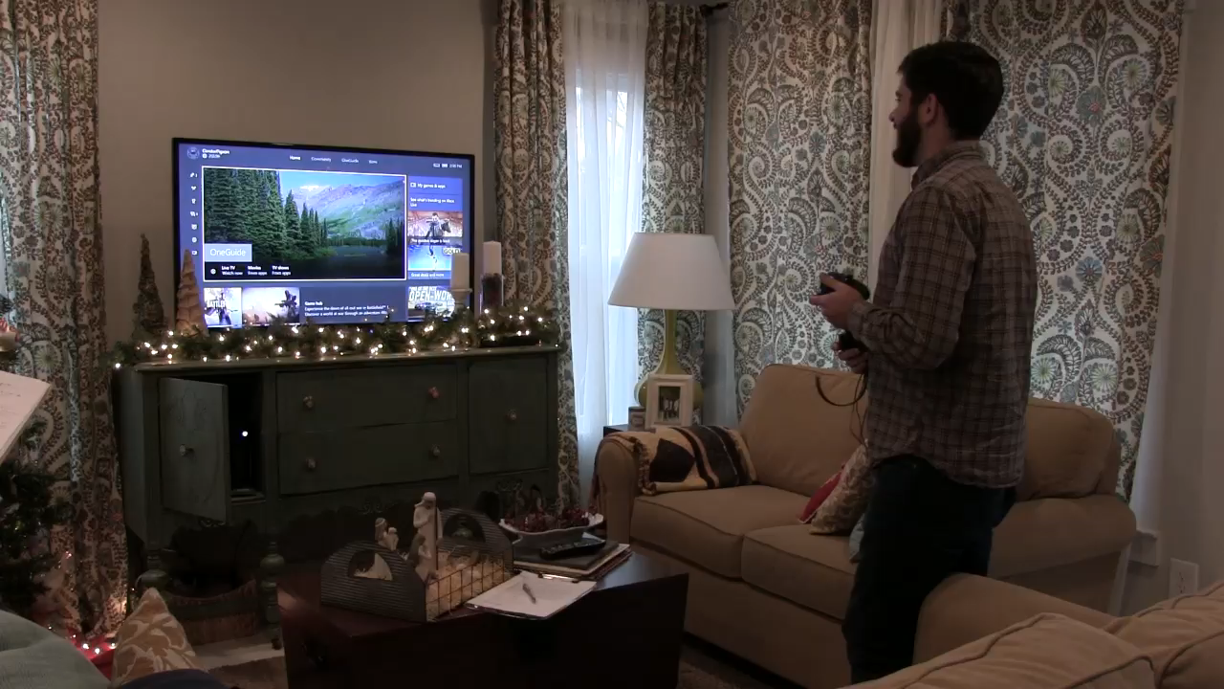
David, 26 years old, Nashville Showing us how he uses Cortana on Xbox

Slide 24
Research Best Practices
Involve a researcher as soon as a project starts.
Ask lots of questions! Foundational research can answer early theories, and we might have insight based on previous projects that can save time and effort.
Invite researchers to project meetings, especially about strategy.
Have frequent conversations with researchers as you are iterating on designs and evaluating potential concepts. Do this early and often.
Don’t be afraid of small studies! Many small studies are often better than doing only one large one.
Get involved! Listen to focus groups, watch user videos, participate in remote lab sessions.
Help researchers understand the best way to share key findings. Who needs to see it? Who should see it? What’s the best format to share?

Slide 25
What have you done for me lately?

Slide 26
News Research
Breaking News focus groups
Local News survey
Mobile Breaking News focus groups
Notifications foundational research
Newsletter foundational research
Business News advisory council
2 focus groups
2 surveys
3 months of access to panel of Insiders

Slide 27
What We’ve Learned
Search is a way to get more details on news.
People use search most often as a way to get more details on news that they saw/heard/read elsewhere.
Search plays the role of adding more details, fact checking, and getting the most recent information.
In the Local News survey, participants indicated that while they got most of their local news from social media, they used search engines to get more details.
In the Mobile Breaking News focus groups we learned that mobile notifications often lead people directly to a source, not search, but that they appreciate search engines for filling in the details.

Slide 28
What We’ve Learned
Search is a way to get more details on news.
People LOVE aggregation. Summaries, timelines, and answers are a huge hit.
People consistently appreciate search– and specifically Bing– for providing well-rounded, comprehensive, aggregated summaries, especially when breaking news happens.
However, people don’t want these summaries to be redundant and they don’t want unnecessary content. Finding the right balance is key.
In the Breaking News focus groups, participants especially liked how Bing pulled together the relevant information in an easy-to-consume package.
The most liked features in the Mobile Breaking News focus groups were the aggregated summaries and timelines.

Slide 29
What We’ve Learned
Search is a way to get more details on news.
People LOVE aggregation. Summaries, timelines, and answers are a huge hit.
Timestamps and sources are super important.
People want the most up-to-date information. They want to know when it was posted (time stamps) and that it’s the most credible/reliable information in that moment.
This was a major feedback point in the Breaking News focus groups, as participants expressed a desire to see clear timestamps on every result, as well as a running list of events to keep them informed.

Slide 30
What We’ve Learned
Search is a way to get more details on news.
People LOVE aggregation. Summaries, timelines, and answers are a huge hit.
Timestamps and sources are super important.
Multimedia options (video, text, etc.) are appreciated… as long as users get to choose.
People like seeing a mix of media– text, video, etc. – when they engage with news. They specifically like the ability to choose which type of content is right for them to engage with in the moment.
The Mobile Breaking News focus groups revealed that people want a mix of text and video. Video is not always an option when people are on the go, so having text as an option is preferred.
The Breaking News focus groups showed the same thing; people like a mix of different content types that allow them to choose.

Slide 31
What We’ve Learned
Search is a way to get more details on news.
People LOVE aggregation. Summaries, timelines, and answers are a huge hit.
Timestamps and sources are super important.
Multimedia options (video, text, etc.) are appreciated… as long as users get to choose.
Mobile is a major opportunity for news.
Mobile continues to be a major opportunity for news, as more and more people use mobile devices as their primary source of news.
In the Breaking News focus groups, participants told us that mobile notifications were one of the main ways they get breaking news.
The Local News survey also revealed that social media app on mobile were a major source of local news.
Participants in the Mobile Breaking News focus groups liked the idea of notifications from a search engine when it took them to a strong mobile answer.

Slide 32
News Research
Breaking News focus groups
Local News survey
Mobile Breaking News focus groups
Notifications foundational research
Newsletter foundational research
Business News advisory council
2 focus groups
2 surveys
3 months of access to panel of Insiders
News-Related Research
Real-time ENA research
Newsletter pilot program
International market values research
UK News Consumption/PopNow user study
Political bias in sources survey
Fake news foundational research and design review
Moments in Time (elections, etc.) user studies
ENA and News Vertical study

Slide 33
New Research!

Slide 34
Key Findings from ENA/News Vertical Study
People use search to get more information about news stories that they hear about somewhere else.
People also use news verticals when they want easy access to the most recent news with lots of details.
Both Google News and Bing News were seen as useful and informative ways of getting news, although both had a few design issues that participants found challenging.
Users did not notice a difference in format when presented with three different answer designs, although they did notice different types of results (video, social, etc.).
Users liked the overall flow of moving through Bing’s news options, from PopNow to SERP to News.

Slide 35
Search engines provide more details on news stories
16/20 participants (7 Google, 9 Bing) said that they use search engines to find out more details about news stories that they heard about somewhere else.
2 participants (Google) explicitly said they use Google News to stay up-to-date. No participants indicated they used Bing News directly.
1 Bing participant said they use the home page/PopNow as a way to get news from a search engine.
1 participant (Google) said they use search engines to fact check the news.
When asked specifically about news aggregator/vertical sites like Google News or Bing News, 8/20 participants said they use them as part of their news consumption.
Participants use these verticals as an easy/fast way to get more news details. They also mentioned using them to get the most recent and detailed content. Personalization and syncing across devices were also drivers of vertical usage. Trust in the search engine (specifically Google) was also mentioned.
For those who don’t use search engine news verticals (11/20, 5 Google, 6 Bing), awareness and ability were issues. Two users mentioned they didn’t know these sites existed. Others mentioned not being sure how to best use them. One participant cited ads/pop-ups as distractions on these pages.

Slide 36
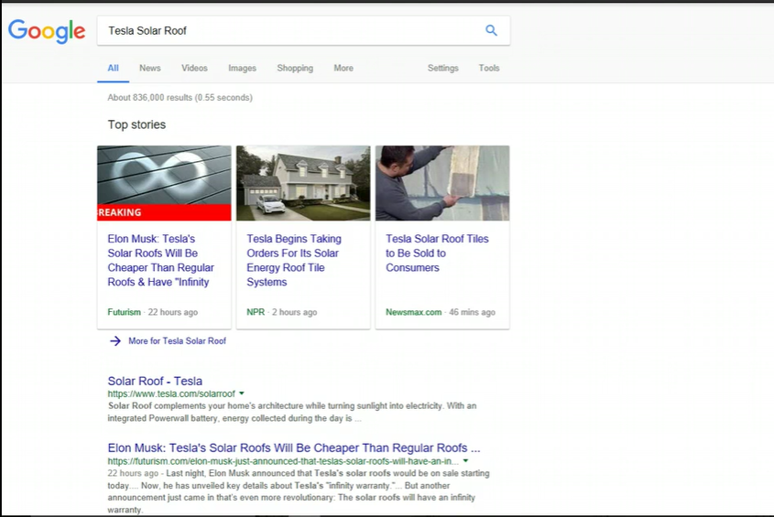
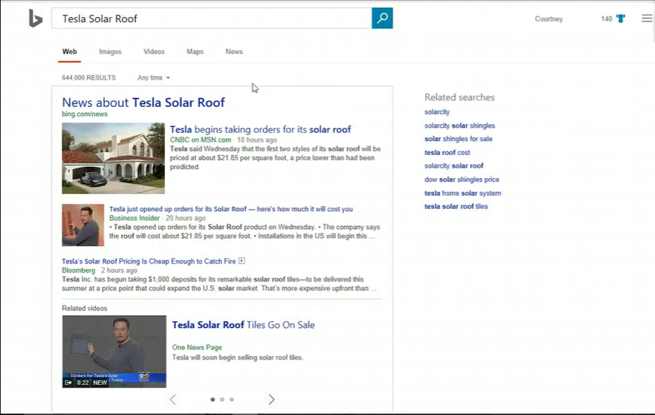
Both Google and Bing met needs when searching for a news story
Participants liked the “Top Stories” section on Google, as it was clear and relevant.
Participants also liked the layout on Bing; they liked that it was clear that this was a news story and that it was clear that these results were related.

Slide 37
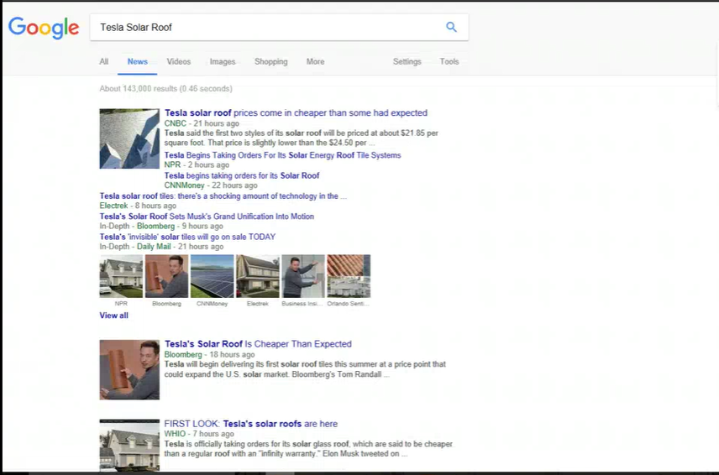
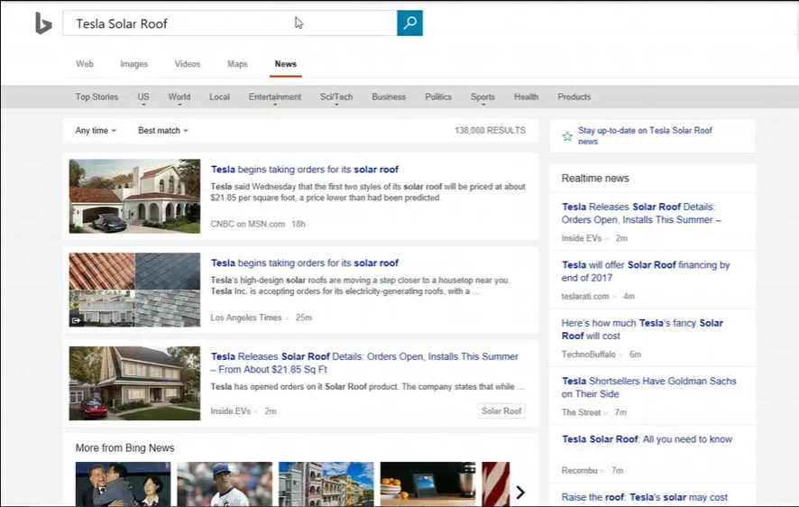
News Verticals meet user needs for news consumption
Both Google News and Bing News were seen as useful ways of staying up on the top news, although participants had specific feedback about each site’s strengths and weaknesses.

Slide 38
Google News Feedback: Detailed
Participants liked the variety of sources, the contextual tags and clear timestamps, and the easy-to-use design.
Participants didn’t like that the top results felt “smushed” together.
Participants were also confused by the “View All” link.
Participants felt like the overall Google News experience provided a good mix of topics, as well as credible sources.

Slide 39
Bing News Feedback: Detailed
Most participants felt the overall design of Bing News was cleaner than Google, although a few felt it was a bit boring or “business-like.”
Participants specifically mentioned that they liked the large images and the subcategories across the top of the page.
Participants felt that while the Bing News vertical provided more variety in content than Google, it was almost too much content.
Specifically, participants mentioned that while they liked the concept of the Realtime News, it was a bit distracting as part of the design.
The variety in content also made it difficult for many participants to determine the credibility of sources, as they felt there were many that were unfamiliar.
Participants also mentioned that they wanted clearer and more specific timestamps.

Slide 40
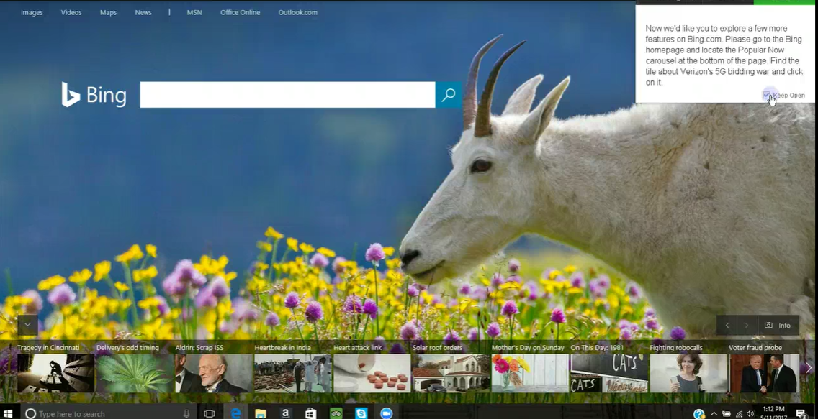

Slide 41
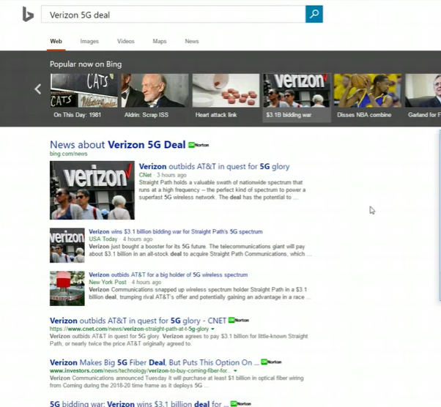
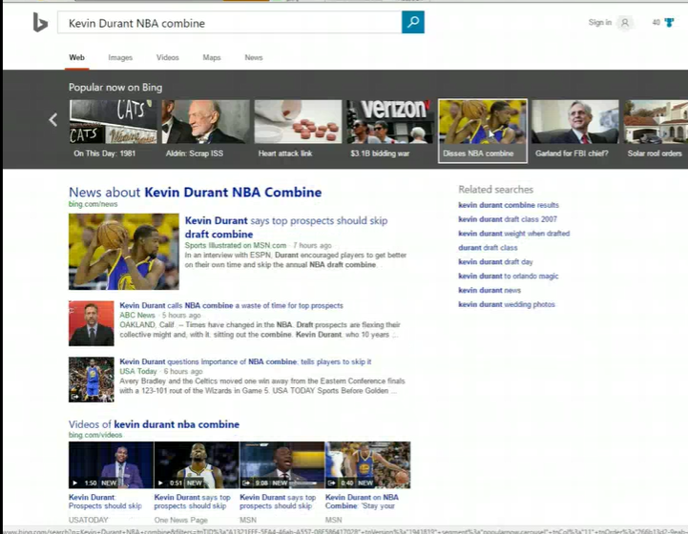
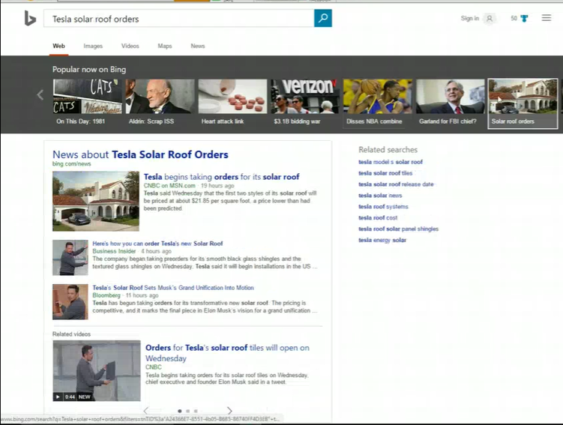
Users notice only subtle differences between ENA and algo answers
12/20 participants did not notice any major differences among the answers.
Of those who did, most mentioned the presence of videos, the video placement, or the social results.

Slide 42
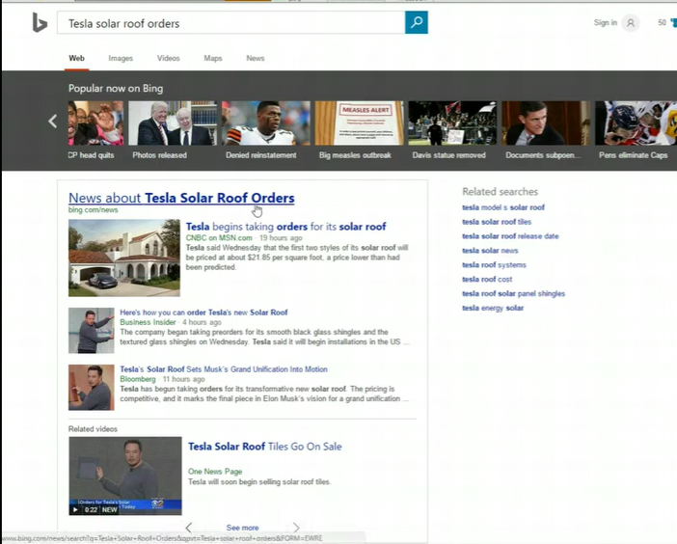
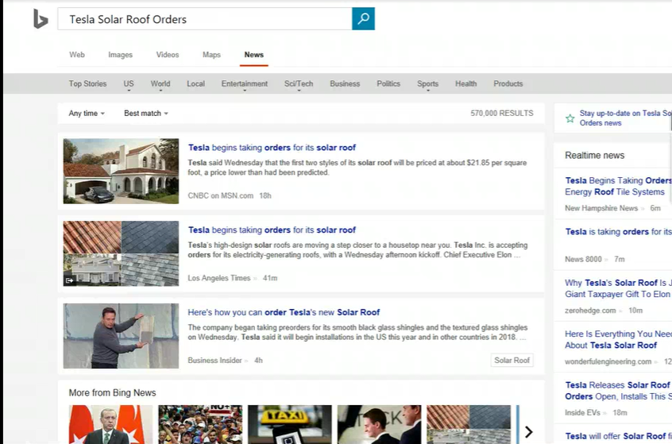
Users like the depth of information provided by Bing
10 participants noticed the clickable “News” link, and 10 participants did not.
In general, participants liked the flow of going from PopNow to the search results to the News vertical. They found it easy and liked the ability to dive deeper into a topic.

Slide 43
Next steps… What else can we study together? What do you want to know? How can research help?

